Slide 1
POWER SYSTEM ANALYSIS 2017 - 2018
4th Year’s Lectures
Part – 2
Gen-Tr-PU
Lecturer : Nesrullah salman khelef
Department of Electrical Power Engineering
College of Engineering
University of Diyala – IRAQ
Ref-1: Hadi Saadat, Power System Analysis
Ref-2: Professor Ali Keyhani Lectures
dr.Nasrallah@engineering.uodiyala.edu.iq
http://www.engineering.uodiyala.edu.iq

Slide 2
Lecture Outline
Generator Model
Transformer Model
Per Unit System

Slide 3
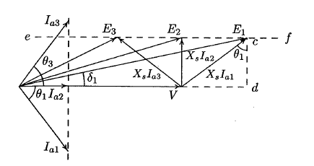
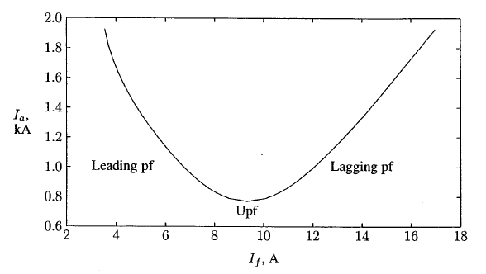
Steady State Characteristics of Cylindrical Rotor Generator
Power Factor Control
$P_{3∅}$=3V$I_{}^{∗}=\left|V\right||I_{a}|\cos{θ}$
cd=$E_{1}\sin{δ_{1}}=X_{s}I_{a1}\cos{θ1}$

Slide 4
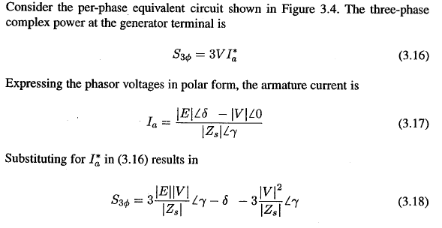
Power Angle Characteristics

Slide 5
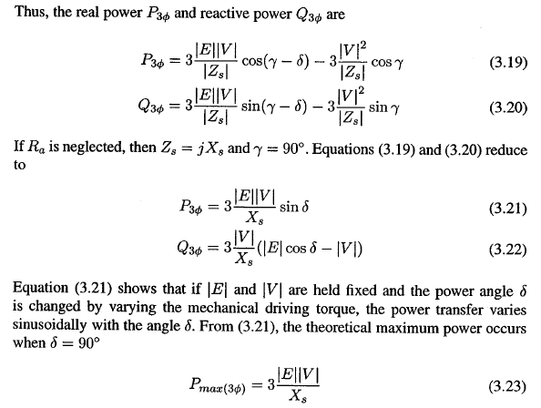

Slide 6
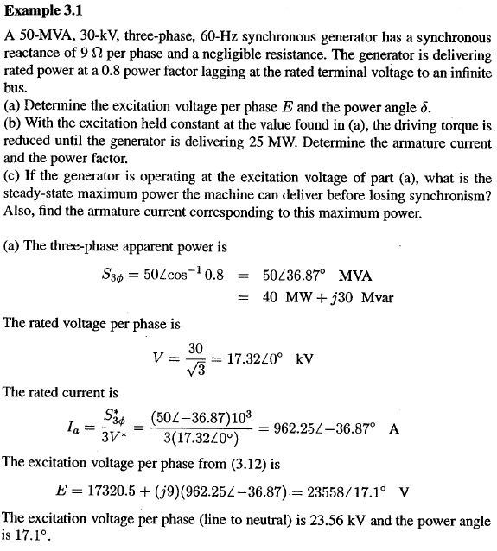

Slide 7
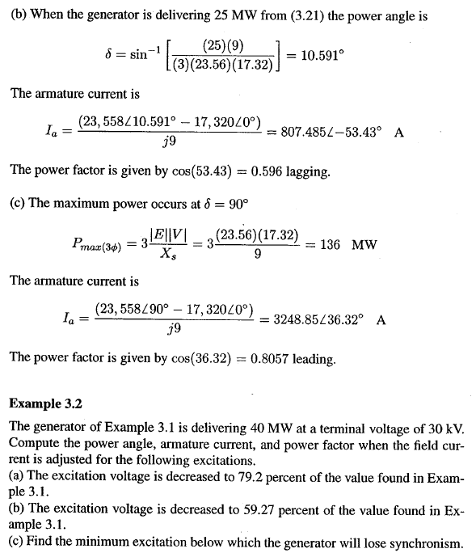

Slide 8
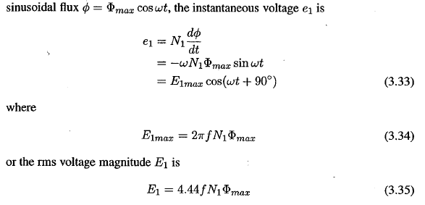
Power Transformer
Equivalent Circuit

Slide 9
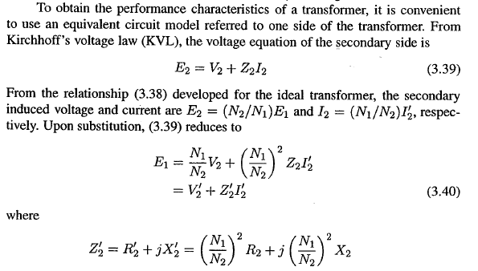

Slide 10
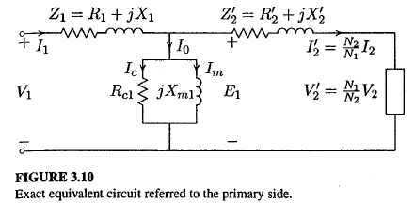
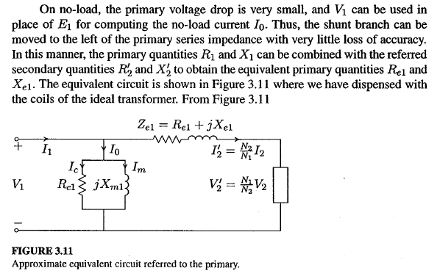

Slide 11
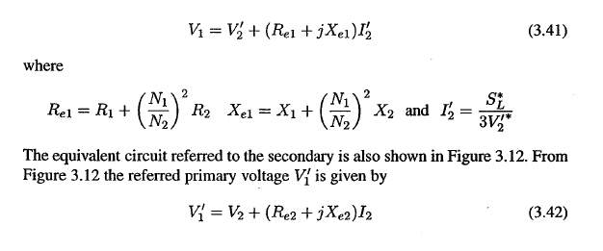
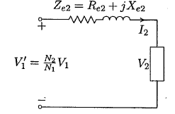
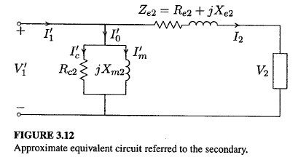
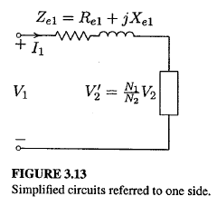
Referring to two sides

Slide 12
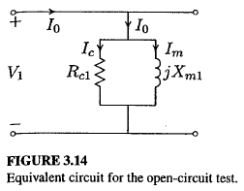
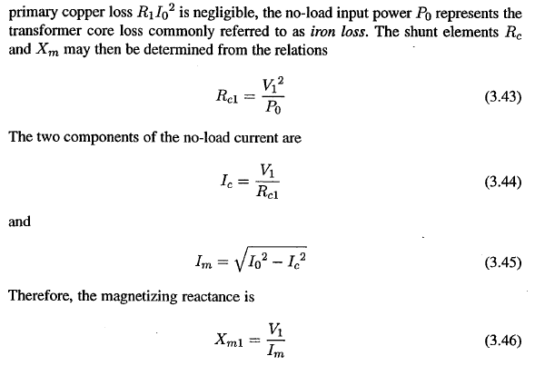
Determination of parameters/ OC Test

Slide 13
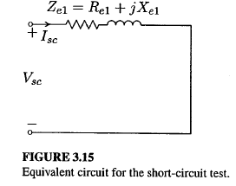
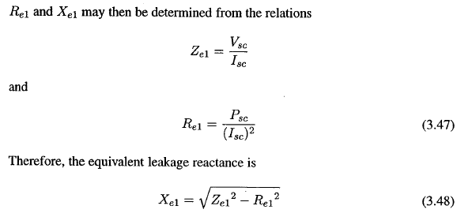
Determination of parameters/ SC Test
Efficiency of Tr

Slide 14
Per-Unit System
In the per-unit system, the voltages, currents, powers, impedances, and other electrical quantities are expressed on a per-unit basis by the equation:
Actual value
Quantity per unit =
Base value of quantity
Then compute base values for currents and impedances:

Slide 15
Per-Unit System
And the per-unit system is:
Percent of base Z

Slide 16
Example 1
An electrical lamp is rated 120 volts, 500 watts. If the voltage applied across the lamp is twice the rated value, compute the current that flows through the lamp. Use the per-unit method.
Solution:
The per-unit equivalent circuit is as follows:

Slide 17
Per-unit System for 1- φ Circuit
One-phase circuits
where

Slide 18
Transformation Between Bases
Generally per-unit values given to another base can be converted to new base by the equations:
When performing calculations in a power system, every per-unit value must be converted to the same base.

Slide 19
Per-unit System for 1-φ Transformer
Consider the equivalent circuit of transformer referred to LV side and HV side shown below:
Define
(1) Referred to LV side
(2) Referred to HV side

Slide 20
Per-unit System for 1-φ Transformer
Choose:
Normal choose rated values as base values
Compute:

Slide 21
Per-unit System for 1-φ Transformer
Per-unit impedances are:
Per-unit equivalent circuits of transformer referred to LV side and HV side are identical !!
So:

Slide 22
Per-unit Eq. Ckt for 1-φ Transformer
Eq Ckt referred to LV side
Per-unit Eq Ckt referred to LV side

Slide 23
Per-unit Eq. Ckt for 1-φ Transformer
Eq Ckt referred to HV side
Per-unit Eq Ckt referred to HV side .

Slide 24
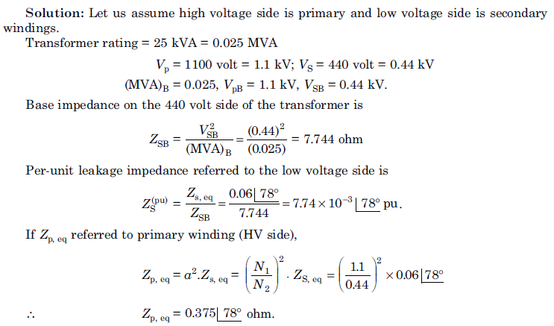
Example for 1-φ Transformer

Slide 25
Example for 1-φ Transformer

Slide 26
Voltage Regulation Example
A single-phase transformer rated 200-kVA, 200/400-V, and 10% short circuit reactance. Compute the VR when the transformer is fully loaded at unity PF and rated voltage 400-V.
Solution:

Slide 27
Voltage Regulation Example
Rated voltage:

Slide 28
Voltage Regulation Example
Secondary side:
Voltage regulation:

Slide 29
Per-unit System for 3-φ Circuits
Three-phase circuits
where

Slide 30
Per-unit System for 3-φ Circuits

Slide 31
Change Between Two Bases
The impedances of generators, transformers and motors supplied by manufacturers are generally given in per-unit values on own ratings. For analysis all impedances must be expressed on common base

Slide 32
Example #1 for 3-φ Transformer
Three 25-kVA, 34500/277-V transformer connected in Δ-Y. Short-circuit test on high voltage side:
Determine the per-unit equivalent circuit of the transformer.

Slide 33
Solution
(a) Using Y-equivalent

Slide 34
Solution
So

Slide 35
Solution
(b) Using Δ-equivalent

Slide 36
Per-unit System for 3-φ Transformer
So

Slide 37
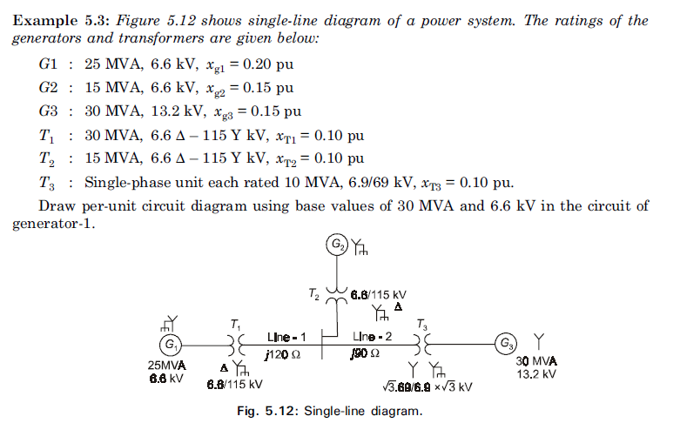
Example #2 for 3-φ Transformer

Slide 38
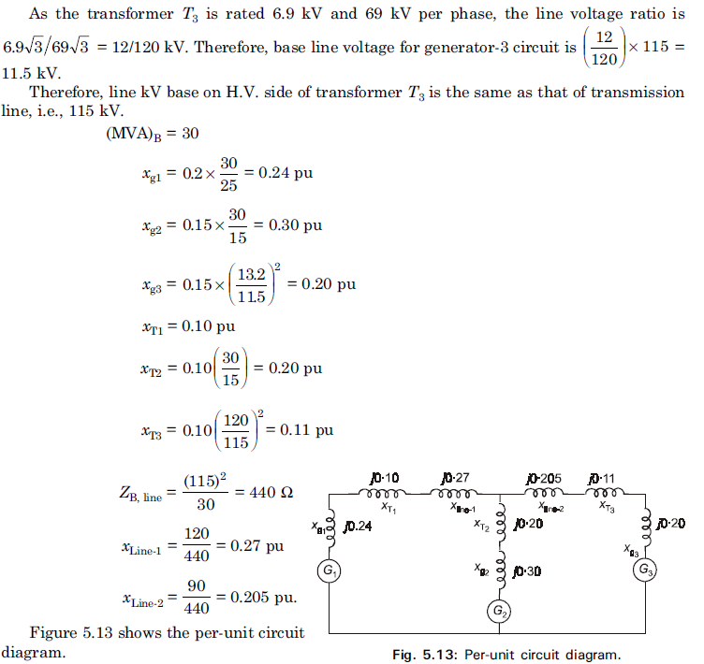
Continue Solution of example # 2

Slide 39
Problem 1
G
20 kV
22kV/220kV
80MVA
14%
220kV/20kV
50MVA
10%
50MVA
0.8 PF lagging
Select V_{base} in generator circuit and S_{b}=100MVA, compute p.u. equivalent circuit.

